Slide 1
Regression
What is Regression?
Regression is a supervised machine learning technique used to predict continuous numerical values based on input features.
Key characteristics:
- Predicts continuous numerical outputs
- Uses labeled training data
- Models relationships between variables
- Minimizes prediction errors

Slide 2
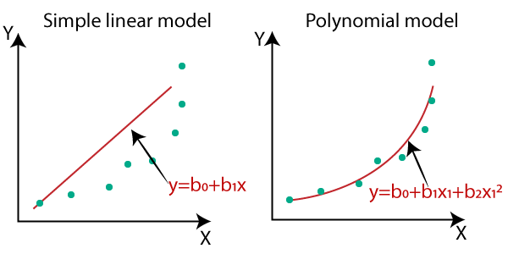
Types of Regression
1. Linear Regression
- Simple linear regression (one feature)
- Multiple linear regression (multiple features)
2. Polynomial Regression
- Captures non-linear relationships
- Higher-order feature relationships
3. Advanced Regression Methods
- Ridge Regression (L2 regularization)
- Lasso Regression (L1 regularization)
- Elastic Net (combines L1 and L2)

Slide 3
Linear Regression Algorithm
Mathematical Formula:
y = b0 + b1 * x1 + b2 * x2 + ... + bN * xN + e;
Where:
y: The predicted value.
b0: The intercept term (bias).
bN: Coefficients for each feature.
xN: Feature values (input variables).
e: The error term.
Cost Function (Mean Squared Error):
J = (1/2m) * sum((y_actual[i] - y_predicted[i])^2);
Where:
J: The cost function value (Mean Squared Error).
m: The number of training examples.
y_actual[i]: The actual value for the i-th example.
y_predicted[i]: The predicted value for the i-th example.

Slide 4
Gradient Descent?
Mathematical optimization algorithm used to minimize cost functions
Attempts to find the best values for the function parameters
Much more efficient than brute force
Fundamental technique in machine learning and deep learning
Iteratively finds the minimum of a function by moving in the direction of steepest descent
The direction that minimizes the error faster

Slide 5
Using Gradient decent: The basics
Notation:
h(x): The predicted output for input x
y: The expected output of input x (the label)
m: The number of observations
A popular cost function is Mean Square Error
J(w) = 1/2m * Σ(h(x) - y)²
Where w is the value of the parameter (weight on edge between nodes)
Gradient measures the slope of a curve using the partial derivative(s)
Gradient at J(w) = 1/m * Σ((h(x) - y) * x) ← assuming we have one parameter, x

Slide 6
Using Gradient decent: The algorithm
Start with a random w
Calculate the predicted values for all the observations
In terms of x and w
Calculate the Mean Square Error
Square the error of each observation observations
(h(x) - y)²
Add up all the resulting squares
Σ(h(x) - y)²
Divide the result by the number of observations to obtain the mean
Σ(h(x) - y)² / 2m

Slide 7
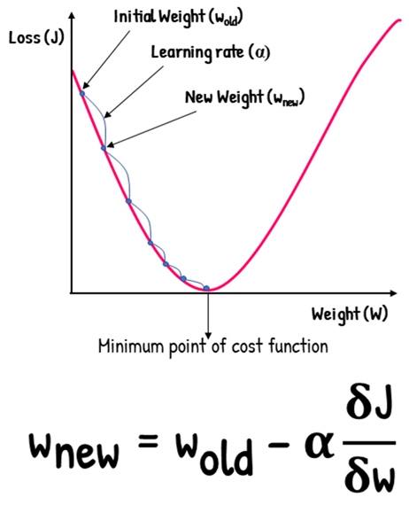
Using Gradient decent: The algorithm
Calculate the Gradient (i.e., the set of partial derivative(s) for the parameter(s))
J(w) = 1/m * Σ((h(x) - y) * x)
Calculate the new w using the Gradient
New w = w – learning Rate * the gradient
If the learning rate is not too high, the next Mean Square Error will be smaller getting you closer to the solution
When the difference between w and w-1 is very small, that signals that no extra training is needed

Slide 8
Using Gradient decent: The algorithm
Intuition
If the gradient is negative, the cost function decreases when w is increased.
If the gradient is positive, the cost function decreases when w is decreased.
The magnitude of the gradient indicates how far www is from the optimal value.

Slide 9
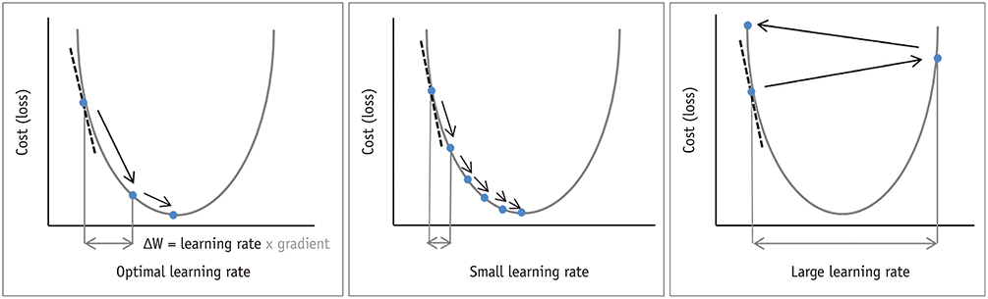
Using Gradient decent: The learning rate
If the learning rate is too small, learning will be slow
Because it will take more iterations to reach the bottom
If the learning rate is too large, training will not happen

Slide 10
Choosing Non-Linear Functions
1. Polynomial Regression
- Data shows clear curvature
- Relationship has multiple turning points
- Example: Temperature variations over a day
2. Exponential Regression
- Data shows rapid growth/decay
- Values increase/decrease by percentage
- Example: Population growth, compound interest
3. Logarithmic Regression
- Growth rate decreases over time
- Diminishing returns relationship
- Example: Learning curves, sound intensity

Slide 11

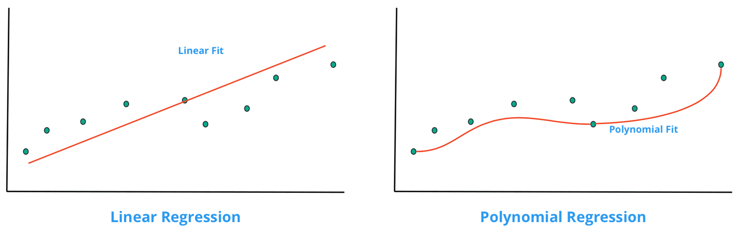
Polynomial Regression
Polynomial Regression is an extension of linear regression.
Linear Regression: Models data with a straight line.
Polynomial Regression: Models data with a curve using polynomial terms.
Used when data shows a nonlinear trend that cannot be captured by simple linear regression.

Slide 12

When to use Polynomial Regression
When a linear model does not fit the data well.
If residual plots show a systematic pattern.
When real-world phenomena exhibit curvature, such as economic growth, biological changes, or physical processes.

Slide 13
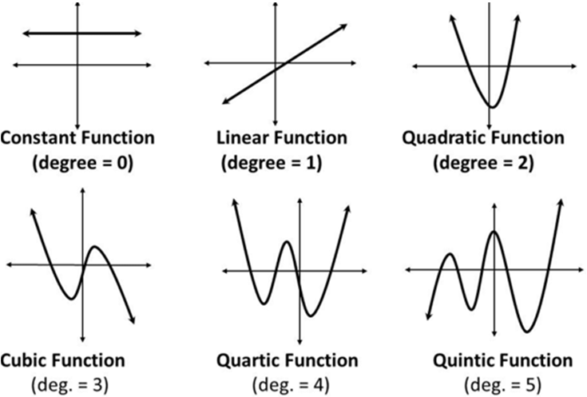
Polynomial Regression equation
The degree determines the flexibility of the model.
Higher-degree polynomials capture more complexity but may lead to overfitting.

Slide 14
Choosing the Polynomial degree
A low-degree polynomial may underfit the data, missing trends.
A high-degree polynomial may overfit, capturing noise rather than the true relationship.
Use K-Fold Cross-Validation and error metrics (e.g., RMSE, R²) to determine the best degree.

Slide 15
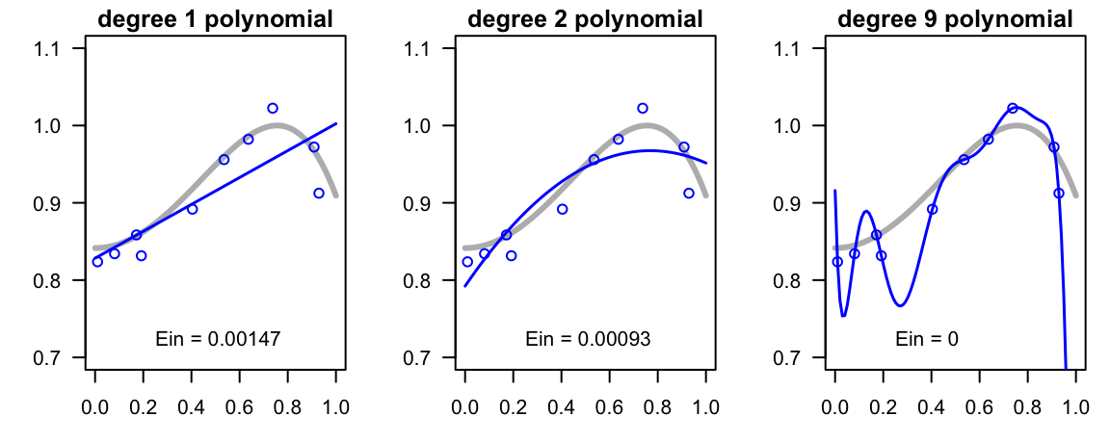
Choosing the Polynomial degree
Why Use Cross-Validation?
Cross-validation is a technique to evaluate the performance of a model on unseen data. It helps:
Avoid overfitting by testing the model on multiple subsets of the data.
Provide a more robust estimate of the model's performance.

Slide 16
The Bias-Variance Tradeoff - Introduction
Fundamental Tradeoff in Machine Learning: All prediction errors can be decomposed into three components:
Bias: Error from oversimplifying assumptions
Variance: Error from sensitivity to small fluctuations in training data
Irreducible Error: Noise inherent in the problem
Mathematical Decomposition: Expected Prediction Error = Bias² + Variance + Irreducible Error
Key Insight: Reducing one component often increases the other, requiring careful balance.

Slide 17
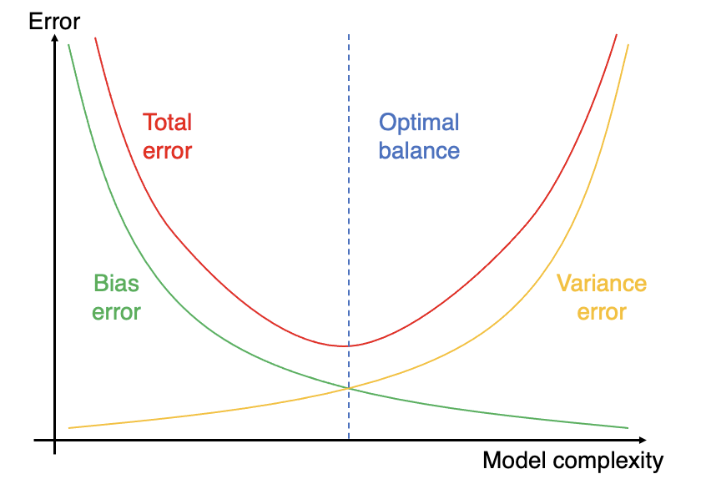
The Bias-Variance Tradeoff - Introduction

Slide 18
Understanding Bias
High Bias (Underfitting):
Model makes strong assumptions about data
Consistently misses relevant patterns
Poor performance on both training and test data
Model is too simple for the underlying relationship
Characteristics:
Low model complexity
High training error
Training and validation errors are similar
Model cannot capture underlying patterns
Examples:
Linear regression for non-linear relationships
Using very few features for complex problems
Overly regularized models

Slide 19
Understanding Variance
High Variance (Overfitting):
Model is highly sensitive to training data
Small changes in training data cause large changes in predictions
Excellent training performance, poor test performance
Model is too complex for the available data
Characteristics:
High model complexity
Low training error, high validation error
Large gap between training and validation performance
Model memorizes rather than generalizes
Examples:
Deep decision trees
High-degree polynomial regression
k-NN with very small k

Slide 20
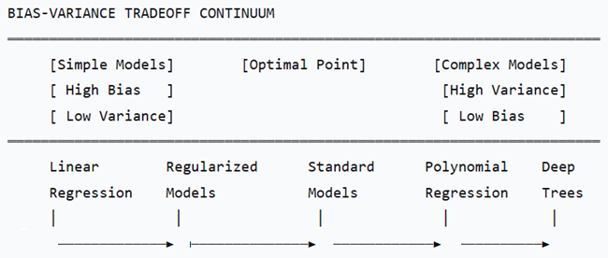
Bias-Variance Tradeoff - Visual Representation
Goal: Find the sweet spot that minimizes total error

Slide 21
Managing the Bias-Variance Tradeoff
Strategies to Reduce Bias:
Increase model complexity
Add more features
Reduce regularization
Use more flexible algorithms
Strategies to Reduce Variance:
Increase training data size
Use simpler models
Apply regularization
Use ensemble methods (averaging)
Data-Driven Approach:
Use validation curves to find optimal complexity
Cross-validation for robust evaluation
Learning curves to diagnose bias vs. variance issues

Slide 22
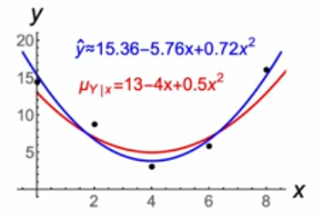
Regularization - Introduction
Definition: Techniques that prevent overfitting by adding constraints or penalties to the model.
Core Principle: Add a penalty term to the loss function that discourages model complexity
General Form: Total Loss = Data Loss + λ × Regularization Term
Where λ (lambda) controls the strength of regularization
Benefits:
Reduces overfitting
Improves generalization
Makes models more robust
Can provide feature selection

Slide 23
Types of Regularization
L1 Regularization (Lasso):
Penalty: λ Σ|wi|
Effect: Drives some weights to exactly zero
Result: Automatic feature selection
Use case: When you want sparse models
L2 Regularization (Ridge):
Penalty: λ Σwi²
Effect: Shrinks weights toward zero
Result: Keeps all features but reduces impact
Use case: When all features are potentially relevant
Elastic Net:
Combines L1 and L2: λ₁Σ|wi| + λ₂Σwi²
Balances feature selection and weight shrinking
Good for correlated features

Slide 24
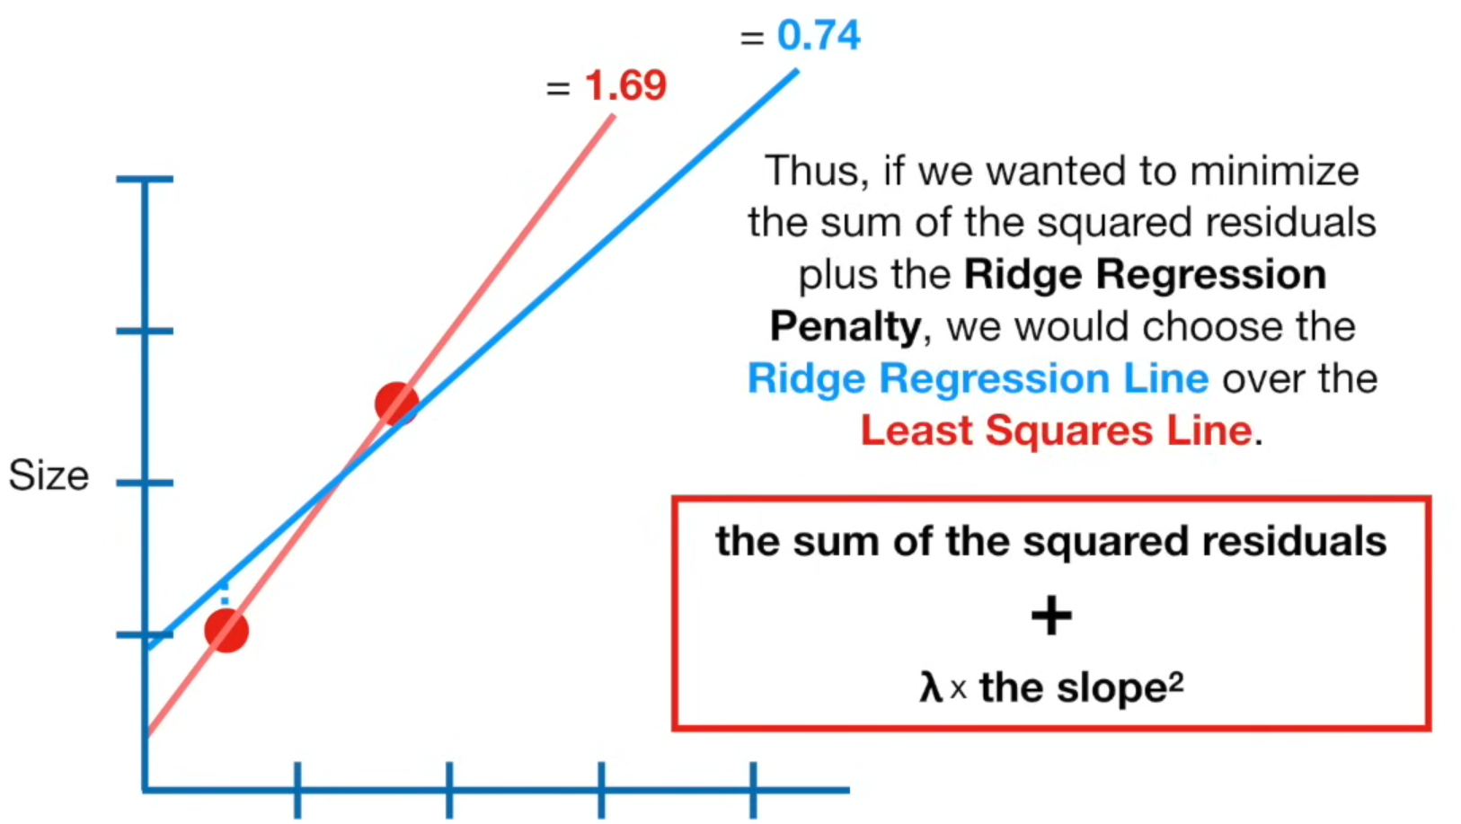
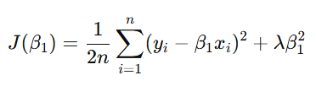

L2 Regularization (Ridge)
Cost function includes:
Mean Square Error
Penalty
One coefficient
One coefficient and intercept

Slide 25
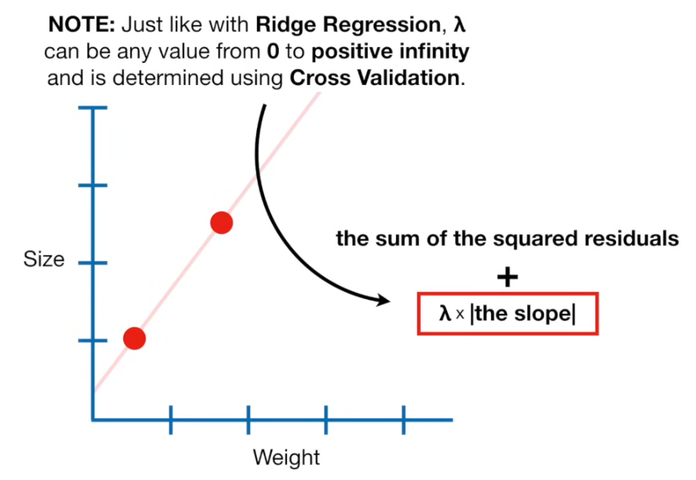
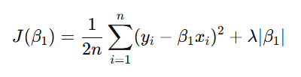

L1 Regularization (Lasso)
Cost function includes:
Mean Square Error
Penalty
One coefficient
One coefficient and intercept

Slide 26
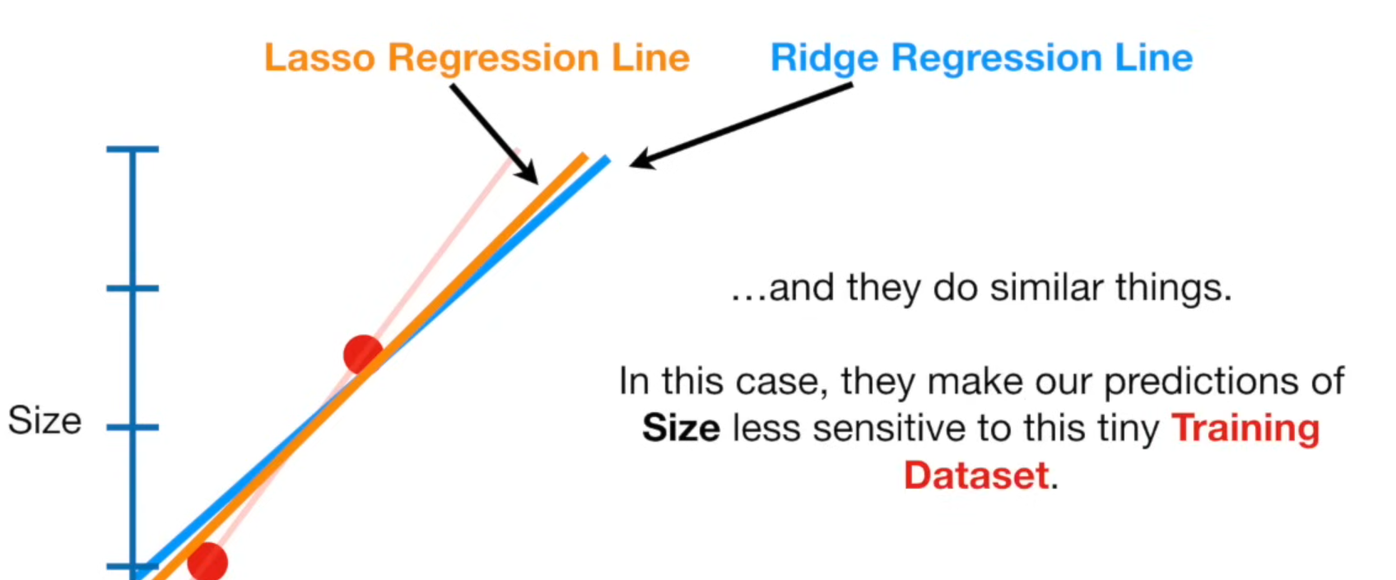
Lasso vs. ridge

